Slide 1


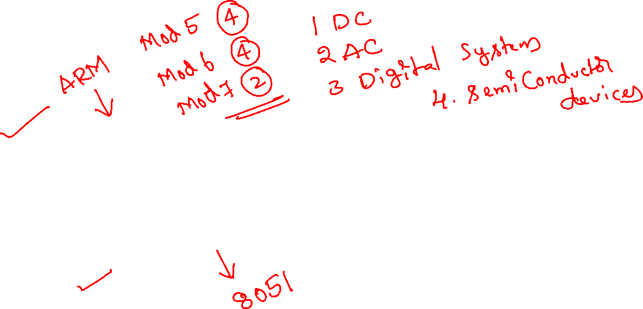
Microprocessor & Microcontroller
Module 5

Slide 2
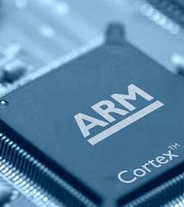
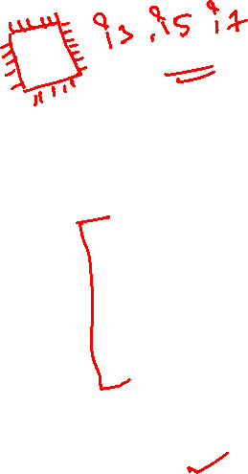
Overview of ARM Architecture
Topic 1

Slide 3

ARM History
1983 developed by Acorn computers
To replace 6502 in BBC computers
4-man VLSI design team
Its simplicity comes from the inexperience team
Match the needs for generalized State of Charge for reasonable power performance and die size
The first commercial RISC (Reduced Instruction Set Computer) implementation
1990 ARM (Advanced RISC Machine), owned by Acorn, Apple and VLSI

Slide 4

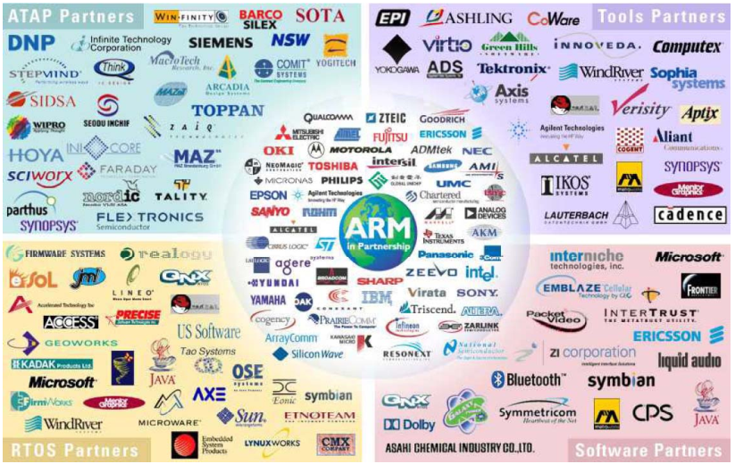


ARM Ltd

Slide 5

Why ARM?
One of the most licensed and thus widespread processor cores in the world
Used in cell phones, multimedia players, handheld game console digital TV and cameras , digital TV and cameras
ARM7: GBA, iPod
ARM9: NDS PSP Sony Ericsson BenQ , PSP, Sony Ericsson, BenQ
ARM11: Apple iPhone, Nokia N93, N800
90% of 32-bit embedded RISC processors till 2009
Used especially in portable devices due to its low power consumption and reasonable performance

Slide 6
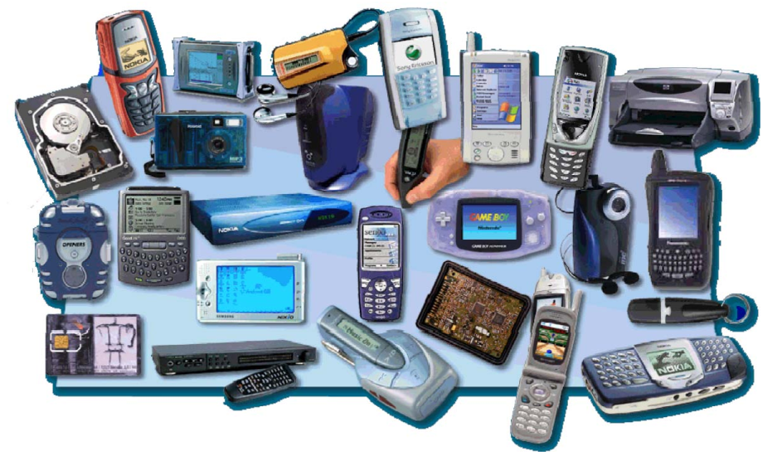
ARM powered products

Slide 7
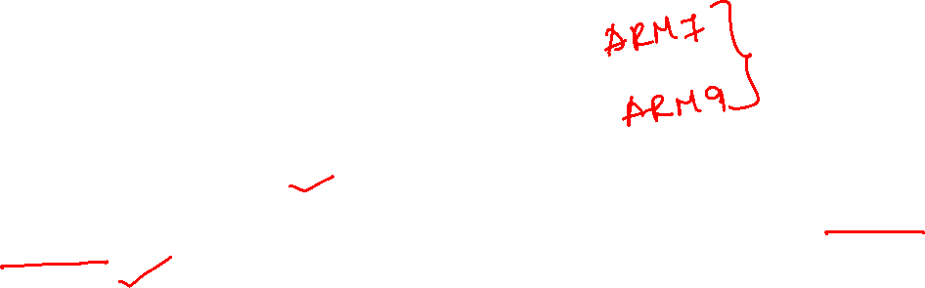
ARM processors
A simple but powerful design
A whole family of designs sharing similar design principles and a common instruction set

Slide 8
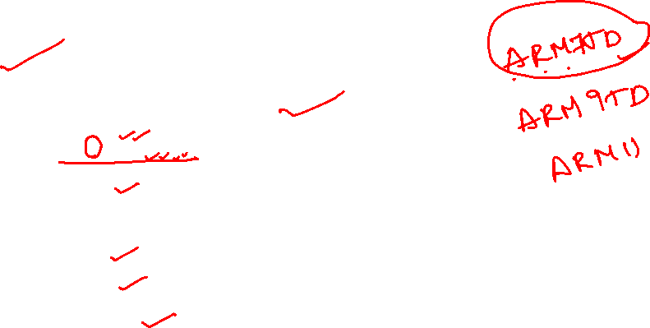
Naming ARM
ARMxyzTDMIEJFS
x: series
y: MMU
z: cache
T: Thumb
D: debugger
M: Multiplier
I: Embedded ICE (built-in debugger hardware)
E: Enhanced instruction
J: Jazelle (JVM)
F: Floating-point
Synthesizable version (source code version for EDA tools)

Slide 9
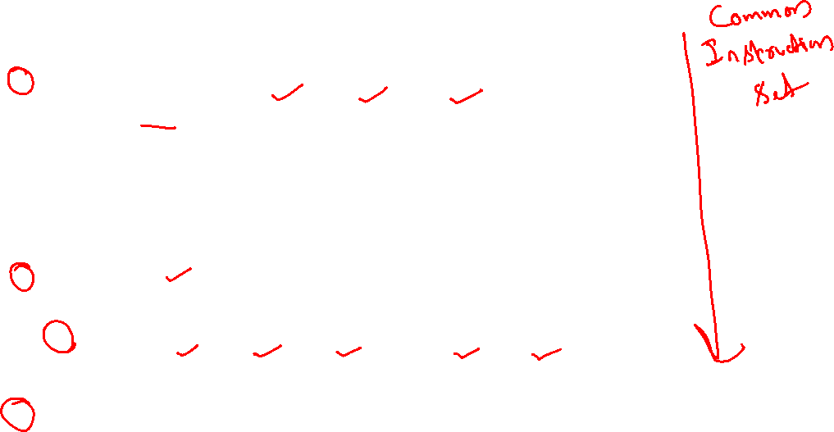
Popular ARM architectures
ARM7TDMI
3 pipeline stages (fetch/decode/execute)
High code density/low power consumption
One of the most used ARM-version (for low-end systems)
All ARM cores after ARM7TDMI include TDMI even if they do not include TDMI in their labels
ARM9TDMI
Compatible with ARM7
5 stages (fetch/decode/execute/memory/write)
Separate instruction and data cache
ARM11

Slide 10
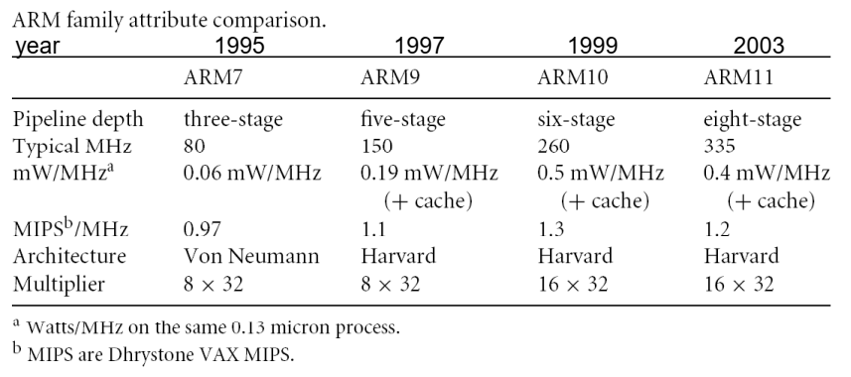
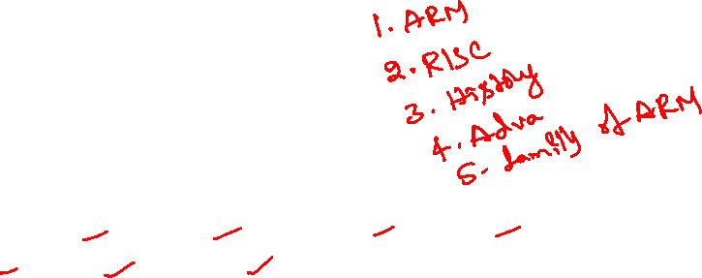
ARM family comparison

Slide 11

ARM is a RISC
RISC: simple but powerful instructions that execute within a single cycle at high clock speed.
Four major design rules:
Instructions: reduced set/single cycle/fixed length
Pipeline: decode in one stage/no need for microcode
Registers: a large set of general-purpose registers
Load/store architecture: data processing instructions apply to registers only; load/store to transfer data from memory
Results in simple design and fast clock rate
The distinction blurs because CISC (Complex Instruction Set Computer) implements RISC concepts

Slide 12

ARM design philosophy
Small processor for lower power consumption (for embedded system)
High code density for limited memory and physical size restrictions
The ability to use slow and low-cost memory
Reduced die size for reducing manufacture cost and accommodating more peripherals

Slide 13
ARM features
Different from pure RISC in several ways:
Variable cycle execution for certain instructions: multiple-register load/store (faster/higher code density)
Inline barrel shifter leading to more complex instructions: improves performance and code density
Thumb 16-bit instruction set: 30% code density improvement
Conditional execution: improve performance and code density by reducing branch
Enhanced instructions: DSP instructions

Slide 14
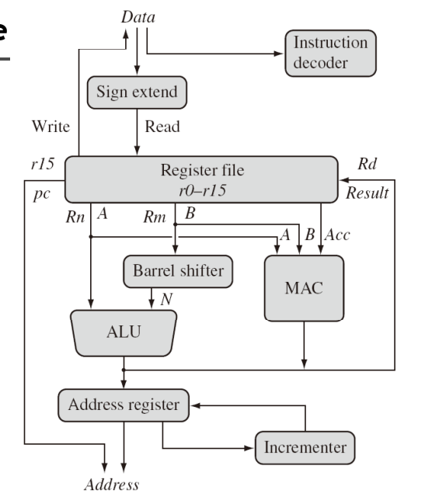
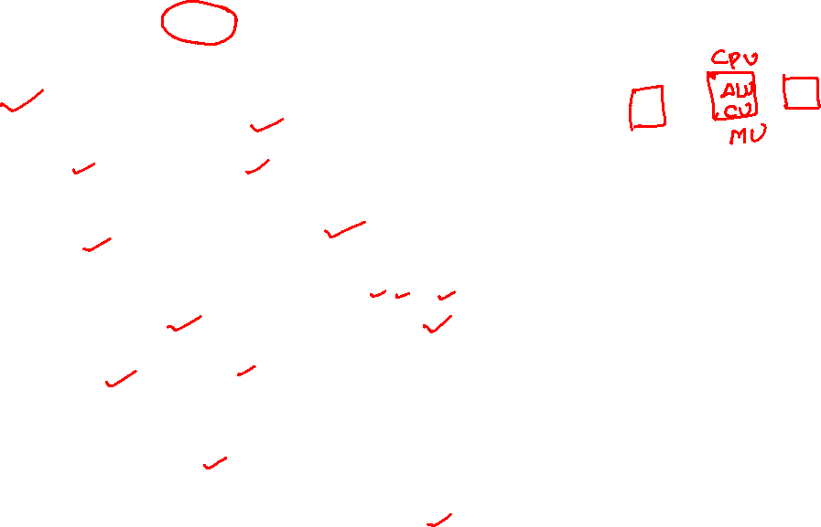
ARM architecture
Multiply Accumulate (MAC)

Slide 15
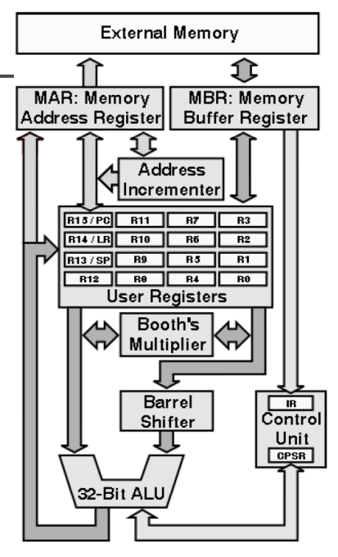


ARM architecture
Load/store architecture
A large array of uniform registers
Fixed-length 32-bit instructions
3-address instructions

Slide 16

Architecture Revisions
ARMv7
version
ARM1156T2F-S™
ARM1136JF-S™
ARMv6
XScaleTM
ARM1176JZF-S™
ARM102xE
ARM1026EJ-S™
ARMv5
StrongARM®
ARM9x6E
ARM926EJ-S™
SC200™
ARM7TDMI-S™
ARM92xT
V4
SC100™
ARM720T™
1994
1996
1998
2000
2002
2004
2006
time
XScale is a trademark of Intel Corporation

Slide 17

Versions mostly refer to the instruction set that the ARM core executes.
The ARM7, which is still the most often used core in a low-power design, executes the version 4T instruction set.
Architectural extensions were added for version 5TE to include DSP instructions, such as 16-bit signed MLA instructions, saturation arithmetic, etc.
The ARM926EJ-S and ARM1026EJ-S cores are examples of Version 5 architectures.
Version 6 added instructions for doing byte manipulations and graphics algorithms more efficiently.
The ARM11 family implemented the Version 6 architecture.
Version 7 architectures (which include the Cortex family of cores, such as the Cortex A8, Cortex M3 and Cortex R4) extended the functionality by adding things such as Thumb2, low-power features, and more security.

Slide 18
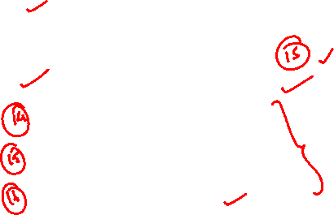
Registers
Only 16 registers are visible to a specific mode.
A mode could access
A particular set of r0-r12
r13 (sp, stack pointer)
r14 (lr, link register)
r15 (pc, program counter)
Current program status register (cpsr)
The uses of r0-r13 are orthogonal

Slide 19
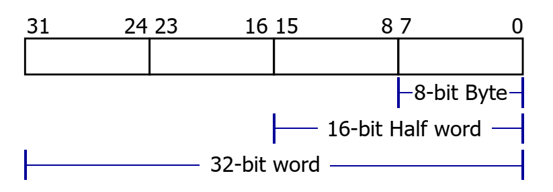

General-purpose registers
6 data types (signed/unsigned)
All ARM operations are 32-bit.
Shorter data types are only supported by data transfer operations.

Slide 20

Program counter
Store the address of the instruction to be executed
All instructions are 32-bit wide and word-aligned
Thus, the last two bits of pc are undefined.

Slide 21
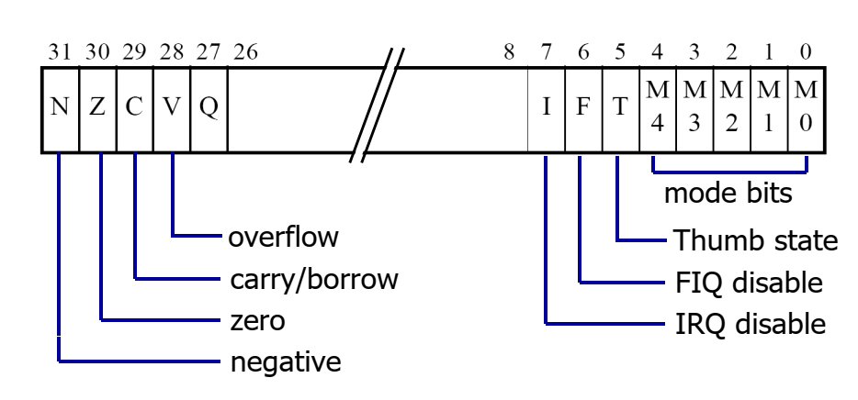
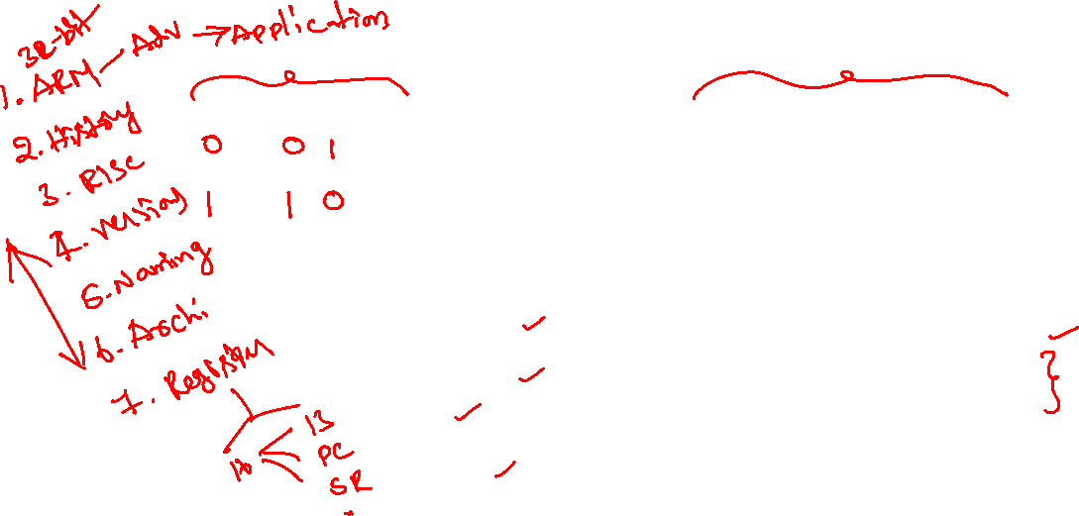
Program status register (CPSR)

Slide 22

Different modes of ARM processor
Topic 2

Slide 23
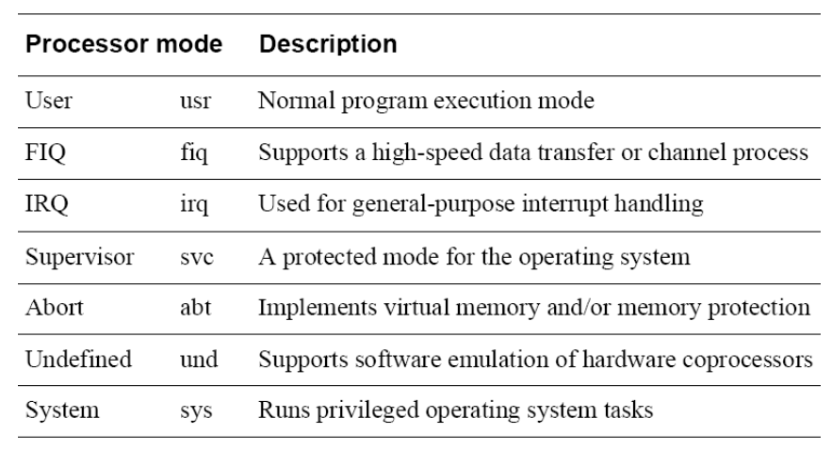
Processor modes

Slide 24

Processor modes
Mode |  | Description | Family
User | usr | Normal program execution, no privileges | All
FIQ | fiq | Fast interrupt handling | All
IRQ | irq | Normal interrupt handling | All
Supervisor | svc | Privileged mode for the operating system | All
Abort | abt | For virtual memory and memory protection | ARMv3+
Undefined | und | Facilitates emulation of co-processors in hardware | ARMv3+
System | sys | Runs programs with some privileges | ARMv4+

Slide 25
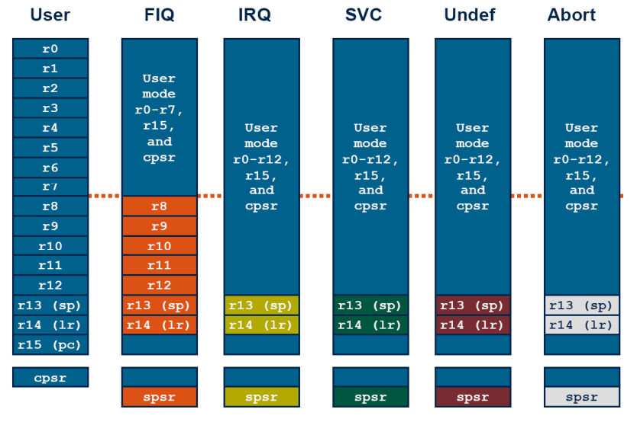

Register organization

Slide 26

Processor modes
User mode
This is the mode in which user application tasks should run. It has access to the base register set, and no privileges.
FIQ mode
The ARM processor supports two types of interrupt handling. There is the regular type of interrupt, and there is this, the fast interrupt. The difference is that fast interrupts can interrupt regular ones.
IRQ mode
This is the other, regular, interrupt mode. Only R13, R14, and CPSR are shadowed.

Slide 27
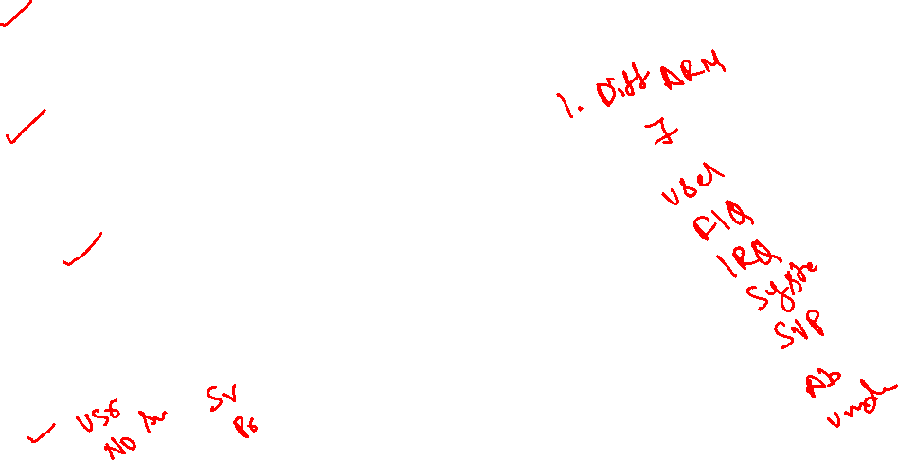
SVC mode
This is the privileged mode reserved for the operating system. R13, R14, and CPSR are shadowed.
Abort mode
An abort is signalled by the memory system as a result of a failure to load either an instruction (Prefetch Abort) or data (Data abort).
Undefined mode
When an undefined instruction is encountered, the ARM will wait for a coprocessor to acknowledge that it can deal with the instruction (if in co-processor instruction space). If no coprocessor responds, or the instruction is one that is not defined, then the undefined instruction vector is taken.
System mode
It is like a cross between SVC and USR. System mode offers the privileges of SVC mode, however it uses the USR registers.

Slide 28
Instruction Set of ARM Processor
Topic 3

Slide 29
Thank you ☺

